Slide 1
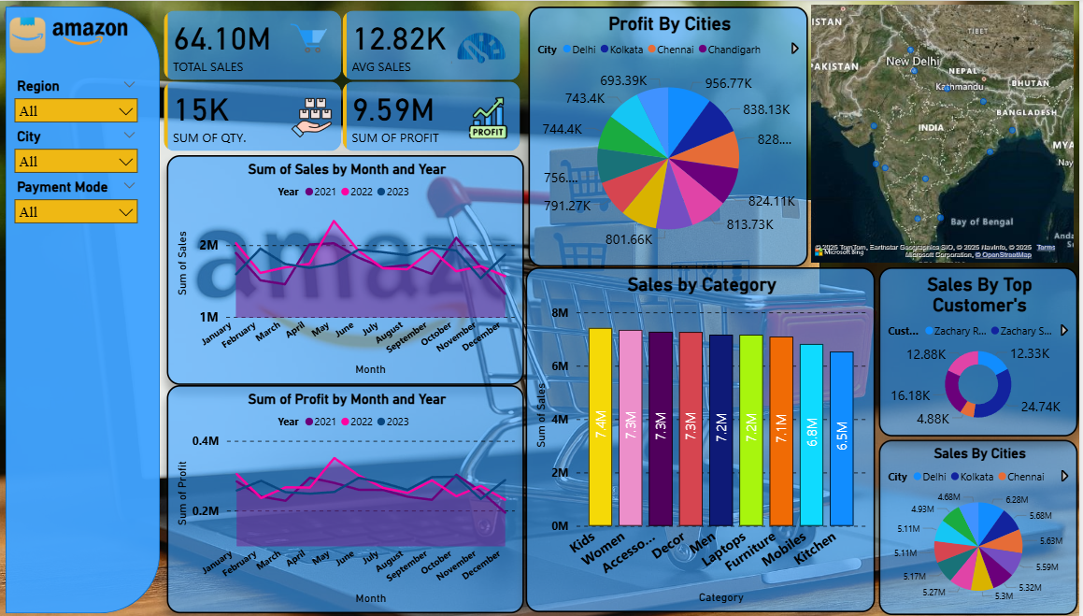

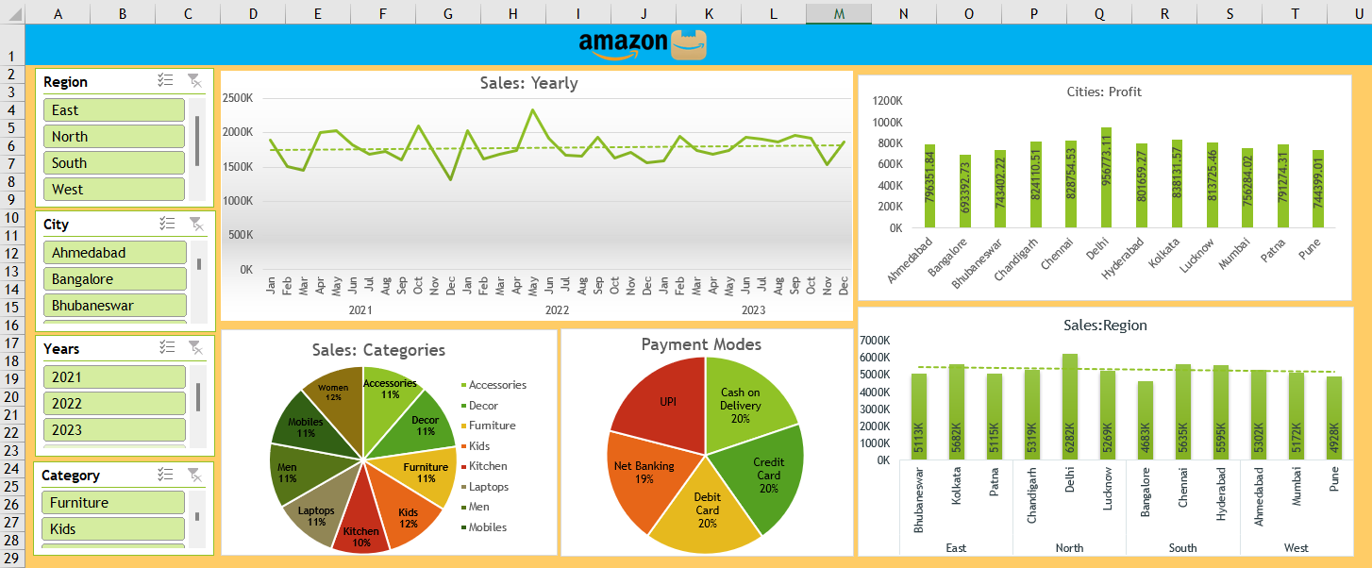
Amazon Sales Analysis Dashboard Project
This project analyses Amazon sales data from FY2021-23 using both Excel and Power BI, aiming to create interactive dashboards that offer profound insights into sales performance, customer behaviour, and profitability across various dimensions like region, city, year, category, and payment mode.

Slide 2




Tools & Technologies Used
Microsoft Excel
Power BI
Utilised for dashboard creation with PivotTables, dynamic Charts, and Slicers. Essential for initial data cleaning and basic transformations using Excel Formulas.
Employed for building interactive and dynamic data visualisations. Advanced DAX measures were crucial for calculating Profit, Sales, and in-depth Category performance metrics.
Power Query
Design & Branding
Instrumental for robust data transformation and sophisticated data modelling, ensuring data integrity and readiness for analysis in both tools.
Canva and Excel's art features were used for design customisation and visual branding, ensuring a professional and intuitive user interface across both dashboards.

Slide 3
Excel Dashboard Overview
The Excel dashboard boasts a clean and user-friendly layout, designed for intuitive navigation.
It integrates interactive slicers allowing users to dynamically filter data by Region, City, Year, and Product Category, enabling flexible analysis.
Visuals include pie charts for comprehensive category sales breakdown and bar charts for detailed profit analysis by cities, offering clear comparative insights.
A dedicated line chart tracks Year-over-Year sales trends, providing insights into performance trajectories.
Key Performance Indicator (KPI) cards are strategically placed for quick, at-a-glance performance metrics.

Slide 4
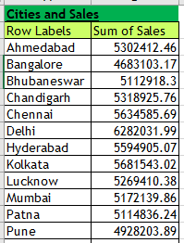
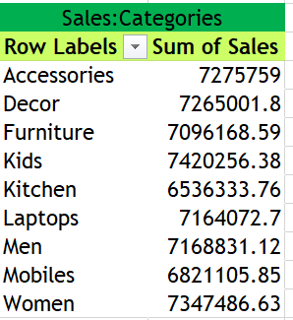
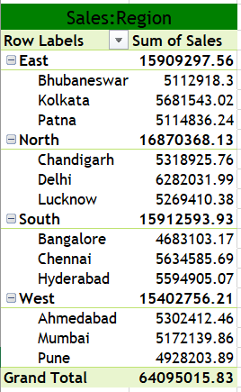
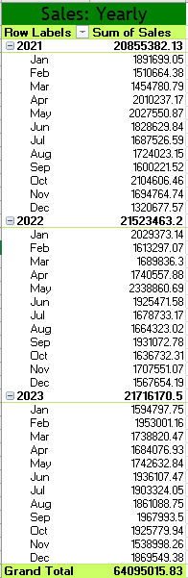
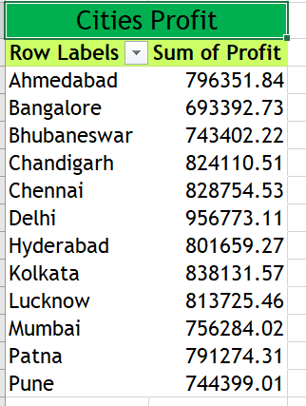
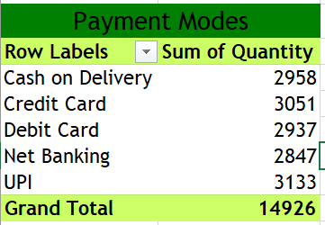
Excel Pivot Tables Previews

Slide 5
Power BI Dashboard Overview
The Power BI dashboard features a modern, dynamic user interface with intuitive dropdown filters for Region, City, and Payment Mode, enhancing user interaction.
It incorporates highly interactive charts, including monthly sales and profit trends, top customer analysis, and category performance insights, allowing for deep data exploration.
Geo-mapping of sales locations offers visual regional insights, identifying key markets and distribution patterns.
Advanced DAX calculations power sophisticated KPIs and detailed profitability analysis, providing granular data metrics for informed decisions.

Slide 6
Key Insights from Amazon Sales Data (FY2021-23)
Profit Hotspots
Preferred Payment Modes
Delhi and Chandigarh emerged as the top profit-generating cities, indicating strong market presence and consumer demand in these urban centres.
Credit Card and Cash on Delivery consistently dominated as the most preferred payment methods, reflecting customer preferences and market dynamics.
Top-Selling Categories
Seasonal Sales Peaks
Furniture, Kids, and Mobiles were identified as the highest-selling categories, highlighting popular product segments and potential growth areas.
Monthly trends consistently show May to July as peak sales months across all analysed years, suggesting seasonal buying patterns or promotional effectiveness.

Slide 7
Thank You
Kushal Gupta Jigyasa Gupta Ashutosh Pandey Vidhi Garg

